Slide 1
Capstone Project GLOBAL TERRORISM (EDA)

Slide 2
CONTENTS
1. Problem Statement 2. Workflow 3. Data Summary 4. Data Cleaning 5. Data Analysis 6. Conclusions 7. Mitigation Measures

Slide 3
1. Problem Statement
We have the data which was originally published by the Global Terrorism Database (GTD). GTD is an open-source database including information on terrorist attacks around the world from 1970 through 2017. The GTD includes systematic data on domestic as well as international terrorist incidents that have occurred during this time period and now includes more than 180,000 attacks. Our aim was to analyze the data and pertaining key findings to terrorist activities.

Slide 4
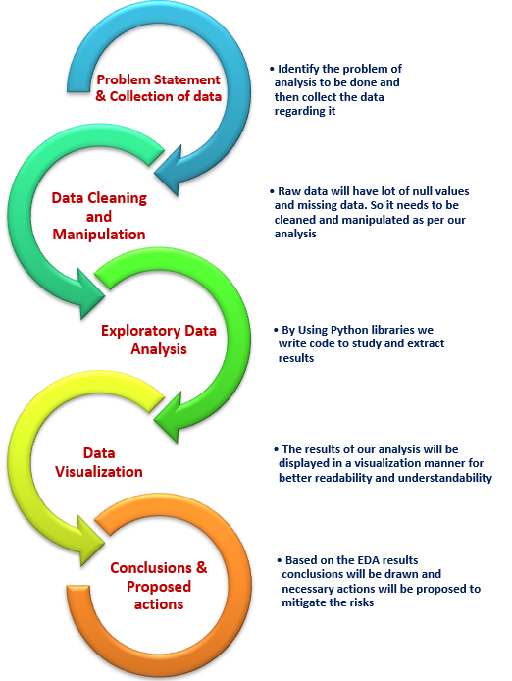
2. Work Flow
Work flow of GTD

Slide 5
3. Data Summary
iyear : The Year in which attacks were happened
imonth : The Month in which attacks were happened
country_txt : Name of the country
region_txt : Name of the Region
provstate : Name of the State
city: Name of the City
latitude : Latitude of the terrorist attacked location
longitude : Longitude of the terrorist attacked location
attacktype1_txt : Attack type of the terrorist attack

Slide 6
success : (0 or 1) indicates whether attack was failure or success
targtype1_txt: Target type of the terrorist attack
gname : Name of the gang committed the terrorist attack
weaptype1_txt: Type of Weapons used for terrorist attack
nkill : no of people killed during the terrorist attack
nwound : no of people wounded during the terrorist attack
Ishostkid: (0 or 1) Indicates whether hostage is kid or not in the attack

Slide 7
4. Data Cleaning
The Dataset contains 181691 rows and 135 columns.
There are 106 columns out of 135 columns are having missing values.
We remove the columns with 85% missing values in the Dataset. After dropping we are left with 47 columns.
In those 47, We drop some columns which are not useful for our analysis. For instance, country column represent the numerical representation of country, country_txt column represents the name of the country. So, the column 'country' is not useful for our analysis. Likewise other columns are as below that we dropped.
➢'eventid','extended','iday','country','targsubtype1','region','weaptype1','crit1','crit2',
'crit3','weapsubtype1','specificity','vicinity','doubtterr','multiple','suicide','target1',
'targsubtype1_txt','attacktype1,'targtype1','natlty1_txt','guncertain1','individual',
'weapsubtype1_txt','property','dbsource','INT_LOG','INT_IDEO','INT_MISC',
'INT_ANY'.

Slide 8
Our Final Dataset will have 181691 rows and 17 columns.
For the missing values in State, City columns, replaced it with 'Unknown'.
For the missing values in Target type replaced with 'Others'.
If number of kills and Wounds are null, then they got replaced by '0'.
For the missing values in is hostkid column, replaced with '0'.
Created Victim columns, which is sum of no people killed and wounded.
Renamed some columns as below for better usability and tracing.
They are as follows:
'iyear': 'Year', 'imonth':'Month','country_txt':'Country','region_txt':'Region','city': 'City', 'provstate': 'State', 'attacktype1_txt': 'Attack_type','targtype1_txt': 'Target_type', 'nkill': 'Kills', 'targsubtype1_txt': 'Target_subtype', 'gname':'Gang_name', 'weaptype1_txt': 'Weapon_Type', 'nwound':'Wounds'

Slide 9
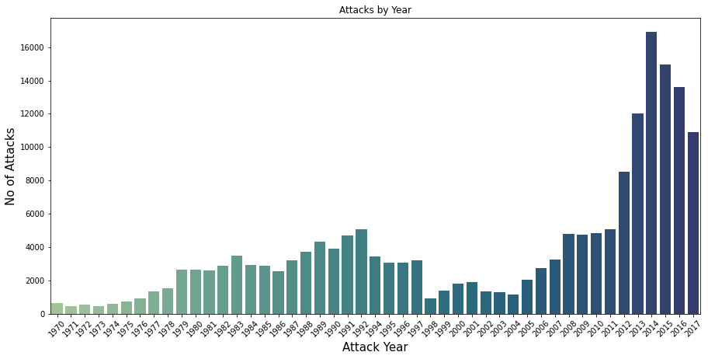
5. Data Analysis: Univariate Analysis
Terror attacks were rapidly increasing from the year 2004 to 2014.
Last 3 years terror attacks were in decreasing trend

Slide 10
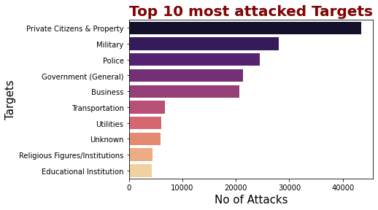

Slide 11
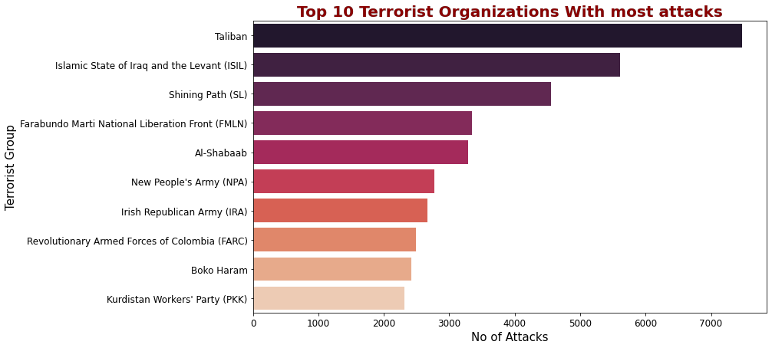

Slide 12
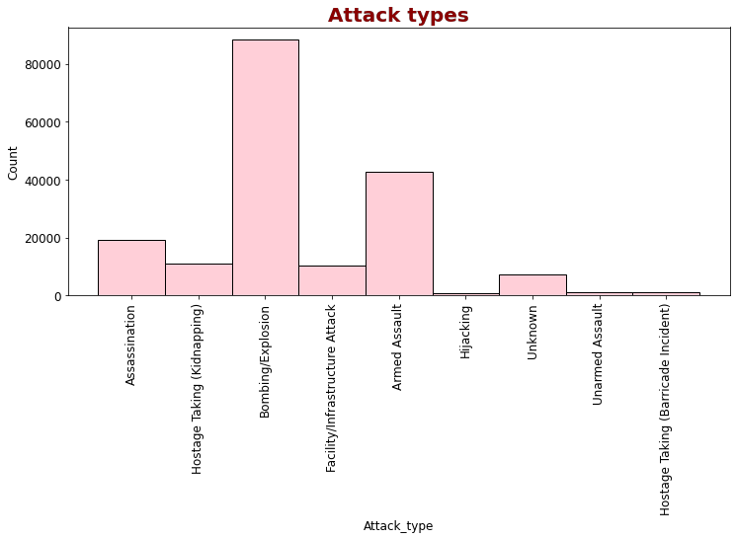
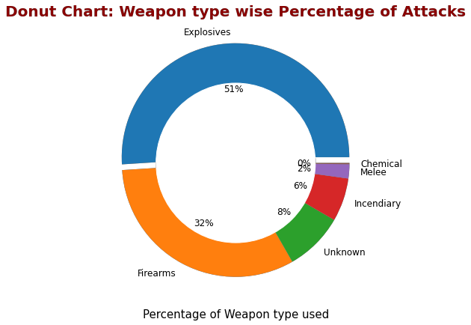

Slide 13
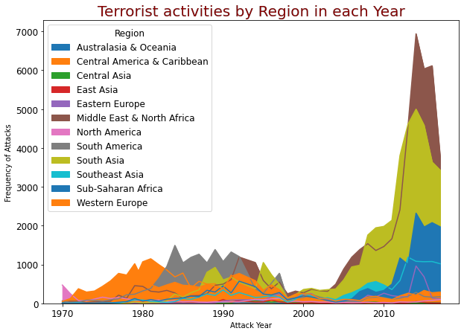
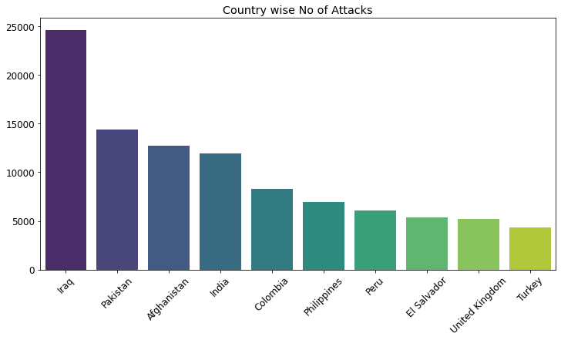

Slide 14
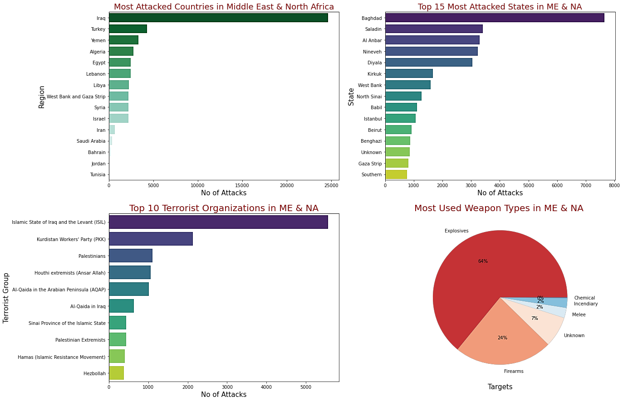
Univariate Analysis

Slide 15
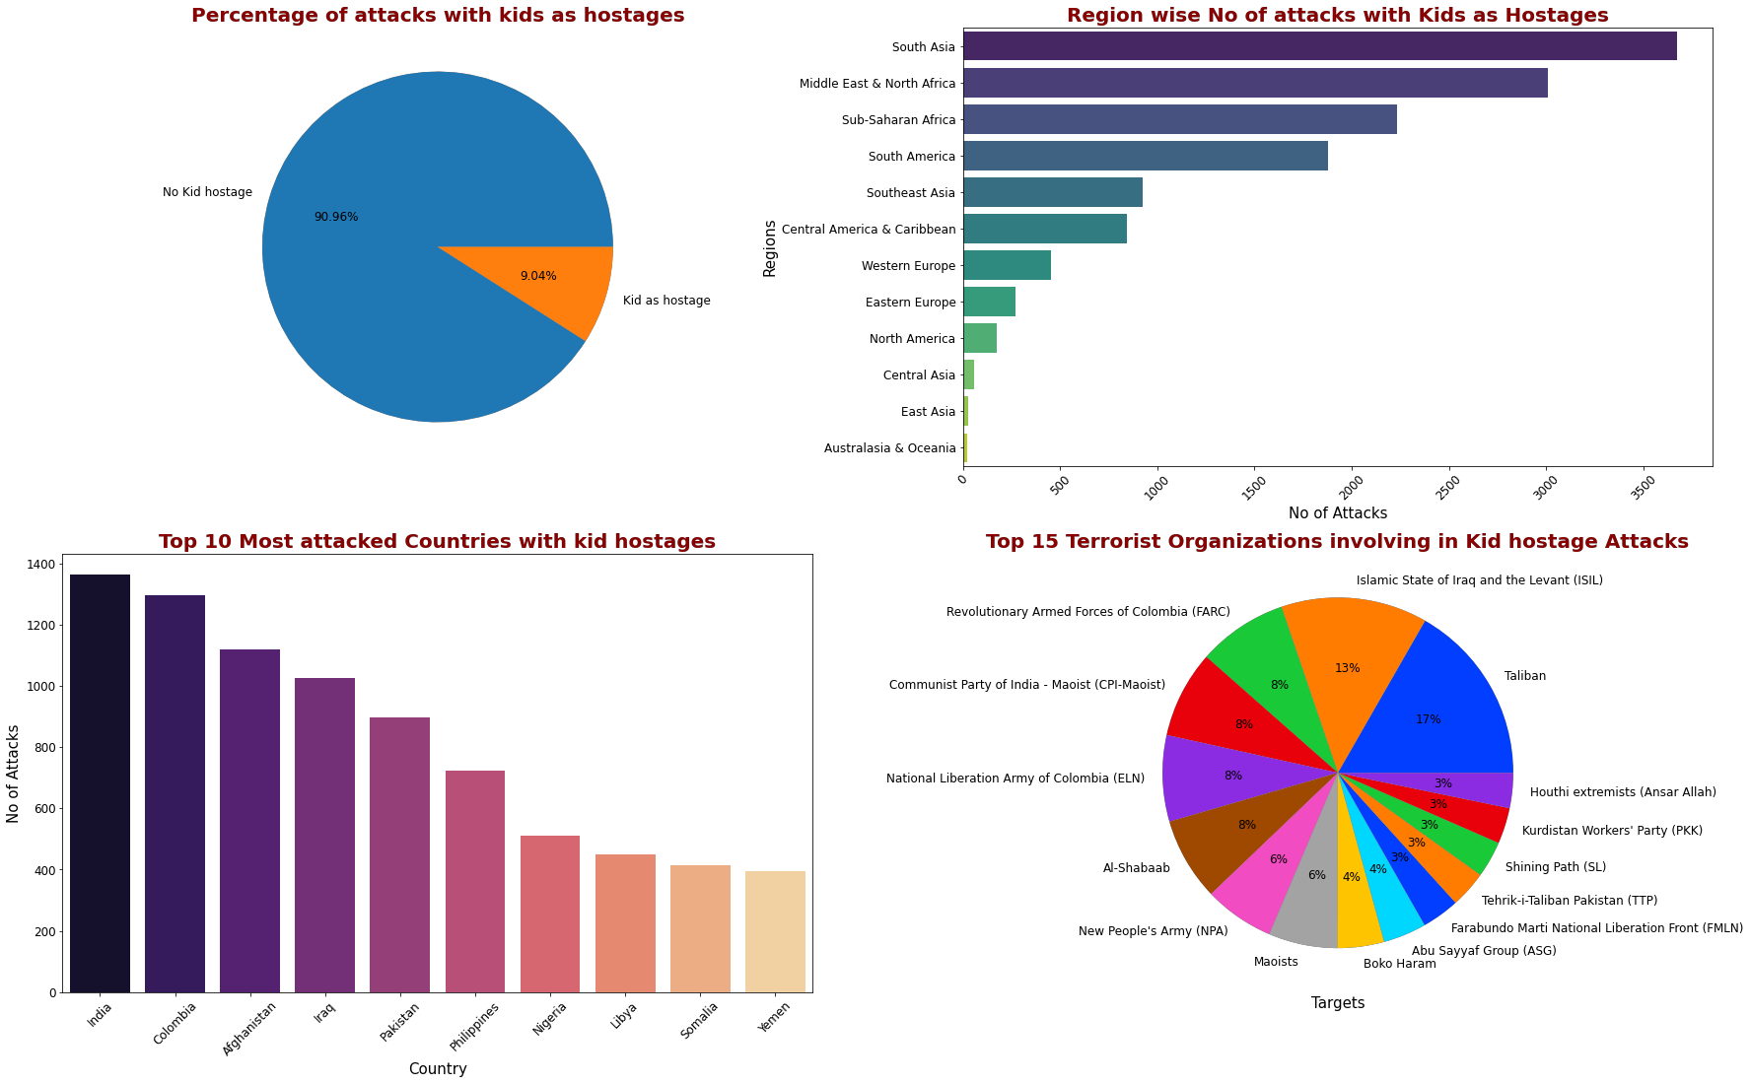
Univariate Analysis

Slide 16
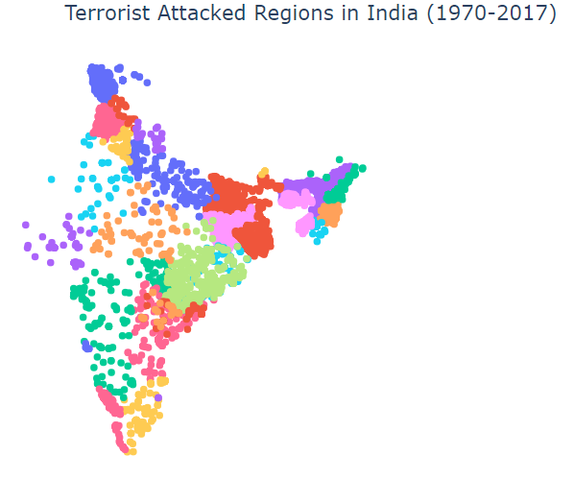
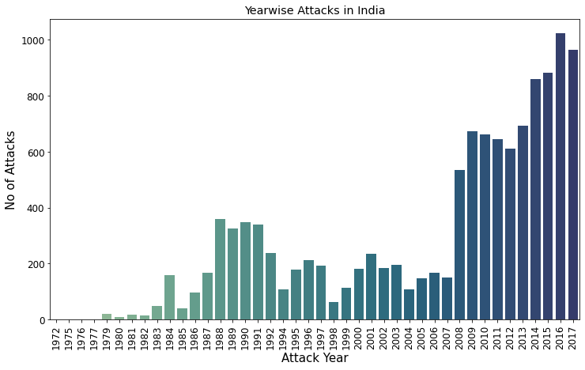
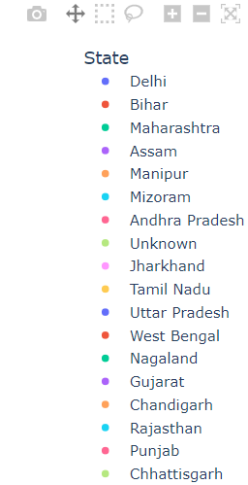

Slide 17
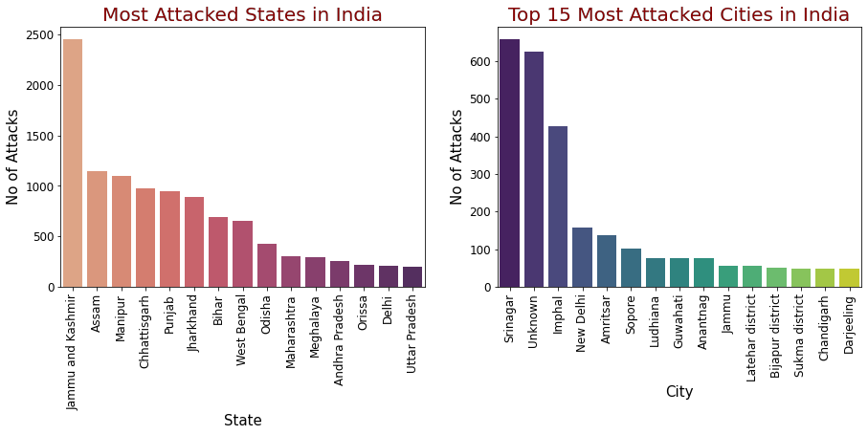

Slide 18
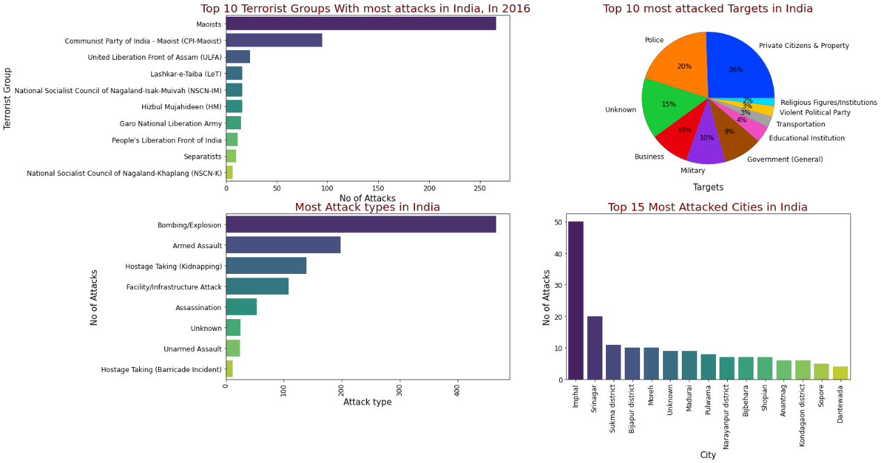

Slide 19
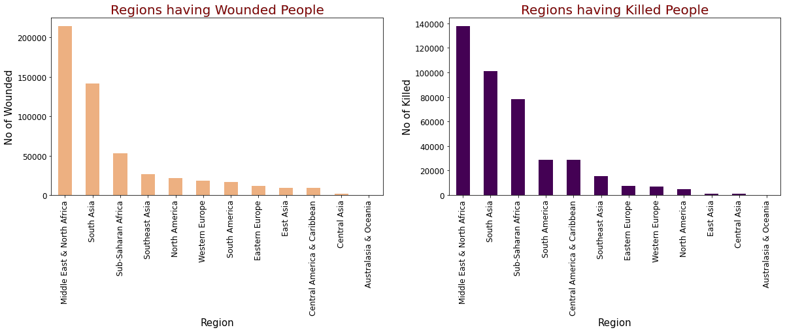

Slide 20
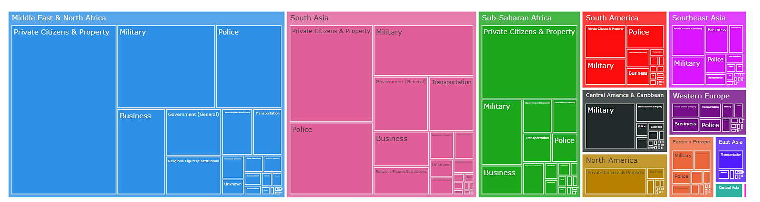
Tree map chart: Grouping the target type groups in different countries

Slide 21
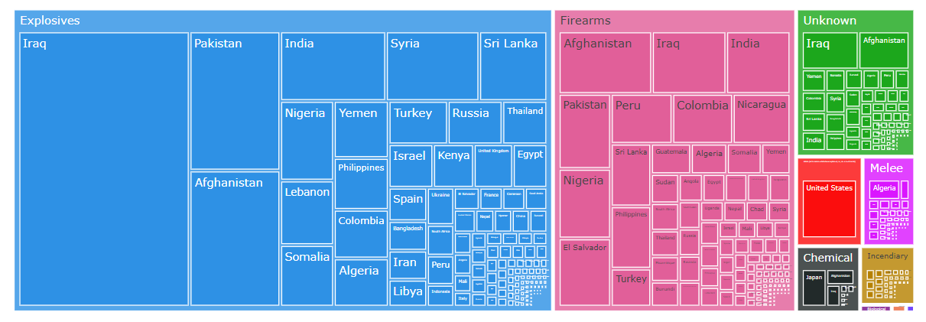
Grouping the weapon type wise attacks with respect to the country

Slide 22
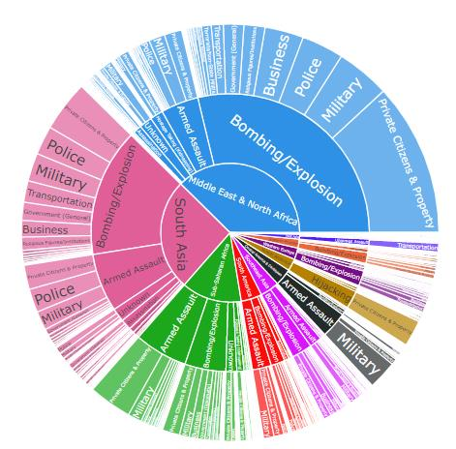
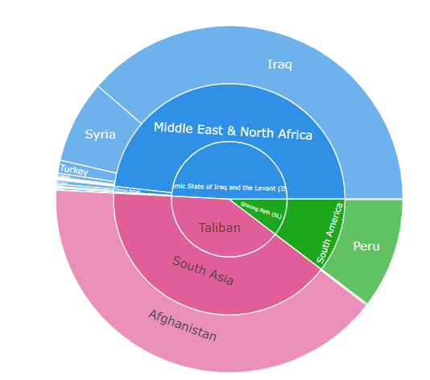

Slide 23
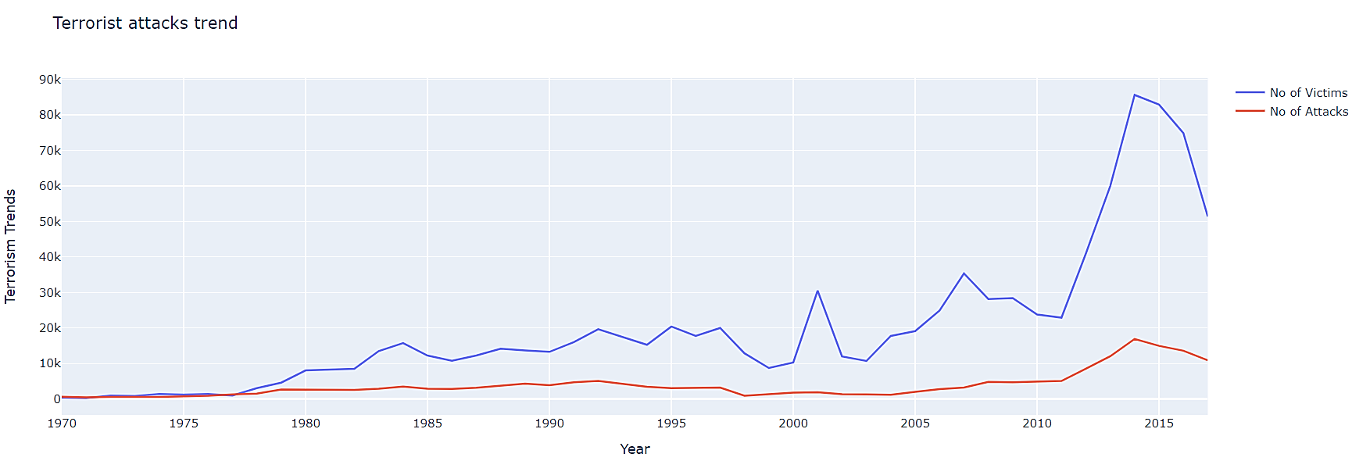
Analysis of number of terrorist attacks vs number of victims

Slide 24
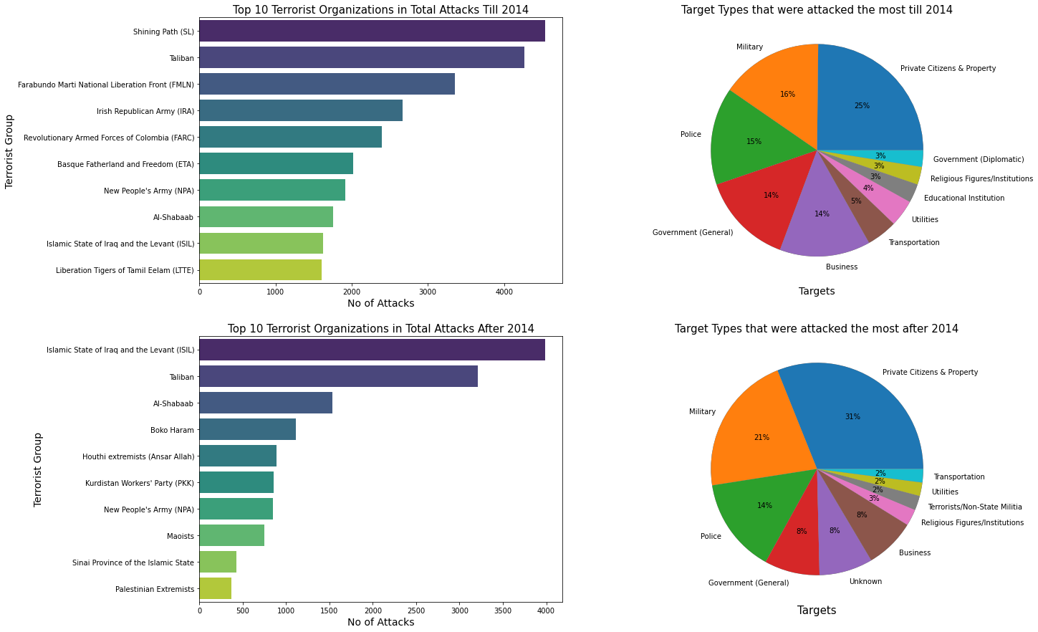
Analysis of Terrorist Organizations & target types before and after 2014

Slide 26
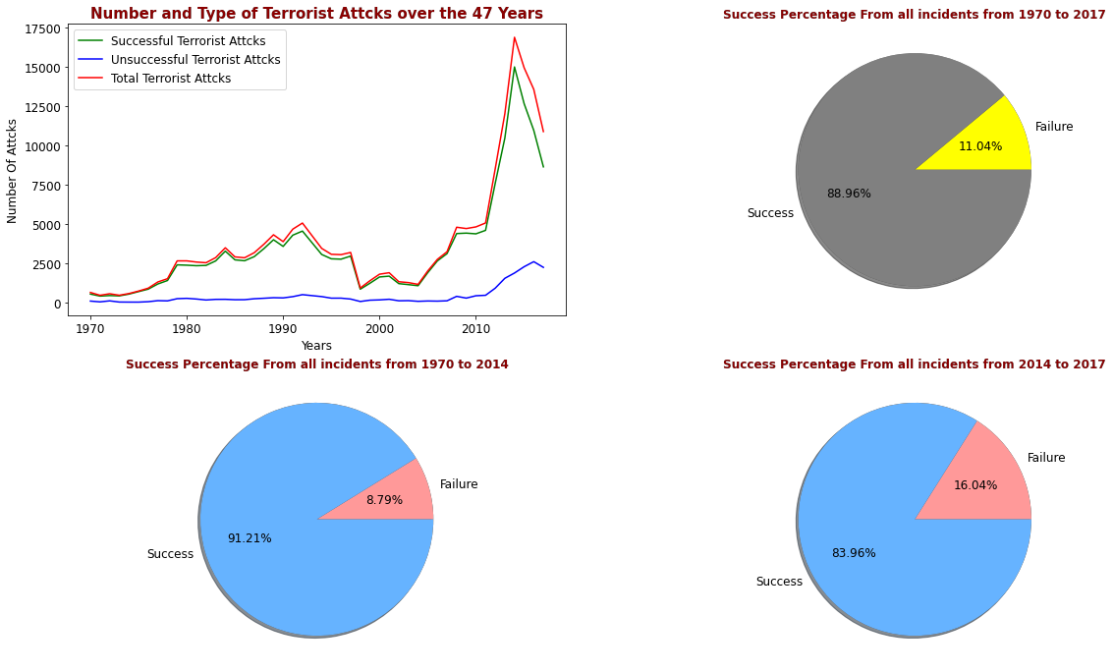
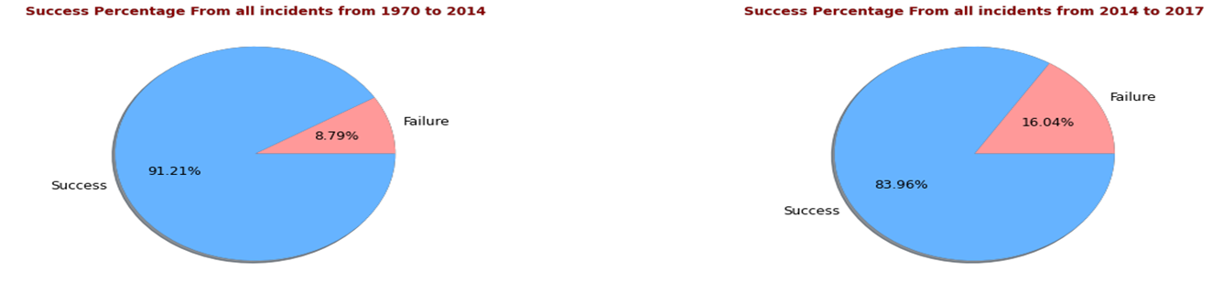
Analysis of success/ Failure attacks

Slide 27


Slide 28
6. Conclusions
Terrorist attack's reached a peak during 2014 and then in 2015, started to drop. The drop in the number of terror attacks is not a sign of improvement in security checks in the society, as the ability to carry out a successful terror attack has not reduced significantly.
Iraq is the most affected nation of all and it has suffered the highest number of attacks followed by Pakistan, Afghanistan and India.
The middle East & North Africa is the most affected region in terms of the number of terror attacks among all the regions followed by South Asia, South America and Sub-Saharan Africa.
Most of the attacks are either bombing or explosions followed by firearms and the most used weapons in the terror attacks are explosives and assault weapons.
Taliban and ISIL are the most active terrorist organizations in the world and Afghanistan is the country that has suffered the most because of Taliban's.

Slide 29
In 2016, India suffered the highest number of attacks, which was peaked during Aug-2016. Most attacks were happened in Srinagar (Jammu & Kashmir). Maoists were responsible for most of the attacks.
This creates a cycle of terrorism as poverty and unemployment help radical ideologists lure youth towards terrorism, discouraging investors which in turn effects the earnings of local governments and leads to further poverty and unemployment.

Slide 30
7. Mitigation Measures
Defining terrorism on a global stage and adopting an international framework to tackle terrorism.
Countries should take measures against illegal immigration by implementing better tracking systems.
Creating a joint task force to improve intelligence sharing and sharing the best practices to combat terrorism.
By imposing strict regulations on the access and sale of dangerous weapons and firearms and tracking sources of such weapons.
Education in population control and improving conditions to encourage employment opportunities might reduce terror activities in the long run.
Strict policies against disinformation and radicalization need to be adopted, including media & internet.
Adopting a global framework and implementing a tough action plan against terror financiers.

Slide 31


